Slide 1
Neuroanatomy
AP Psychology
Cerepak 2015

Slide 2
This unit is called the Neuroscience Behavior- it is also known as Biopsychology. Considering the units we just covered, or information you might have learned in other classes, what do you know about neuroscience? What do you want to know?
KWL In your notebook
What do you know about neuroscience already?

Slide 3
Rene Descartes and Dualism
When we began this quarter in Psychology, you learned that before psychology was a science it was mostly philosophers that thought about the mind body connection.
Rene Decartes was one of these early psychologists. He is known for his stance on dualism, that is, the mind and the body are separate entities. Once the body is gone, the mind and soul live on

Slide 4
Dualism
Even today, We seem to act like our minds are separate from our bodies because we use terms that lay claim to your body parts (my arm, my leg).

Slide 5
Science says, Mind=Brain
Hwever, science supports the idea that the brain produces the mind and is one with the body; in other words, monism.
We are going to get up close and personal to talk about the very things that connect our brain to our body..

Slide 6
Neuroanatomy
Neuroanatomy is the study of the parts and functions of neurons.
Neurons are individual nerve cells and they make up our entire nervous system, from the brain to the neurons that fire when you stub your toe.

Slide 7
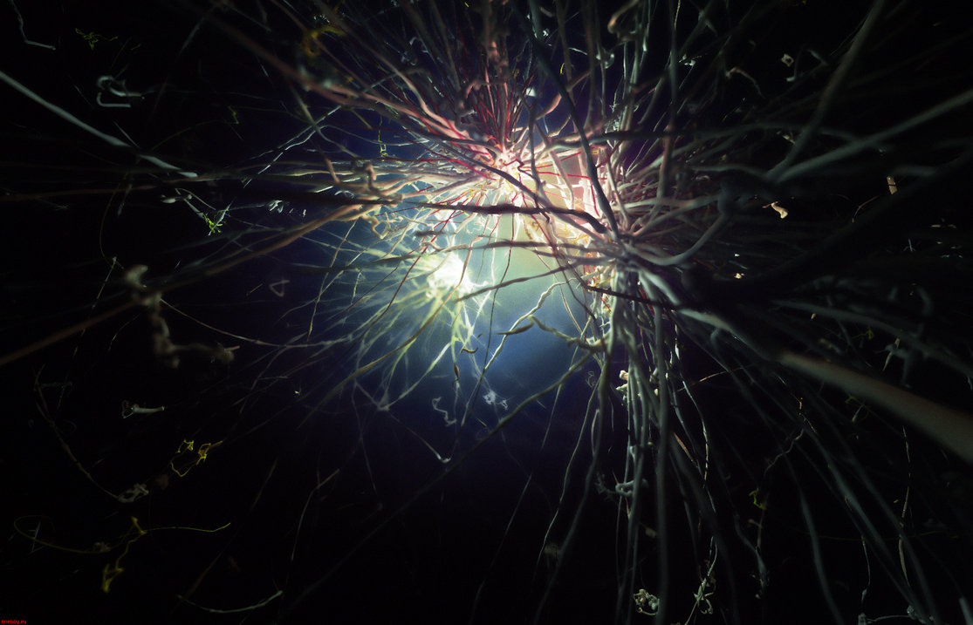
Every neuron is made up of discrete parts:
Dendrites- root like particles of the cell that stretch out from the cell body.
Dentrites grow to make synaptic connections with other neurons.

Slide 8
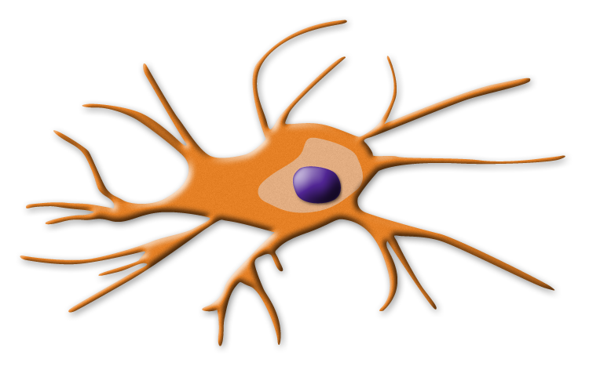
Soma (Cell Body)
Contains the nucleus and other parts of the cell needed to sustain its life.

Slide 9
Axon and Myelin Sheath
Axon- wire like structures ending in the terminal buttons that extends from the cell body.
Myelin Sheath- a fatty covering around the axon of some neurons that speeds neural impulses.

Slide 10
Terminal Buttons and Neurotransmitters
Terminal Buttons-the branched end of the neuron that contains neurotransmitters
Neurotransmitters are chemicals that enable neurons to communicate.
Neurotransmitters fit into the receptor sites of the dendrites of other neurons like a key fits into a lock.

Slide 11
It’s time for the Neuron Dance!
I need volunteers!
Dendrite - wave your left hand.
Soma - Nod your head, Axon - shake your torso (mylineate and shake faster)
Axon terminal - flick your right hand.
Neurotransmitters-just go!

Slide 12
Synapse [SIN-aps]
(means junction point)
The space between the axon tip of the sending neuron and the dendrite of the receiving neuron
tiny gap at this junction is called the synaptic gap or cleft
Neurons work by electricity. Electricity will not go over a space, so it stops.

Slide 13
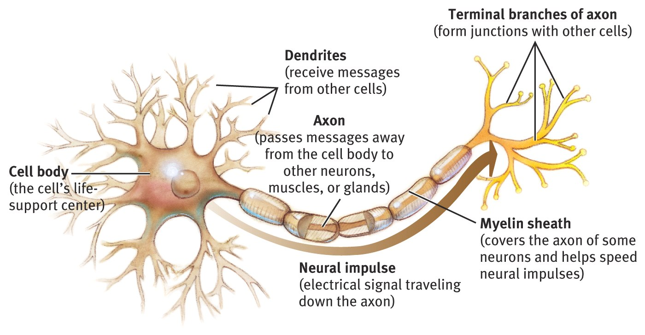
Structure of a Neuron

Slide 14
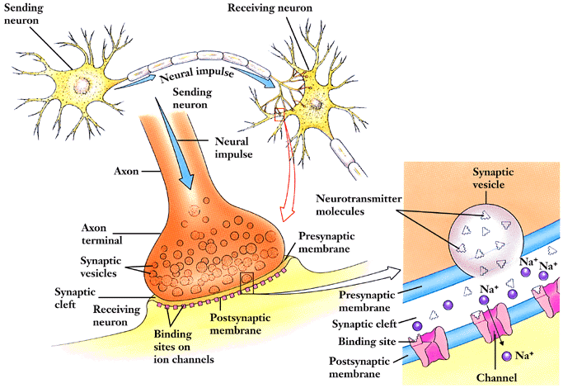
Neural Communication

Slide 15
Neurotransmitters
chemical messengers that traverse the synaptic gaps between neurons
when released by the sending neuron, neuro-transmitters travel across the synapse and bind to receptor sites on the receiving neuron, thereby influencing whether it will generate a neural impulse
If the message is for arm movement, the vesicles only release neurotransmitters involved in the movement circuit.
There are dozens of different neurotransmitters.

Slide 16
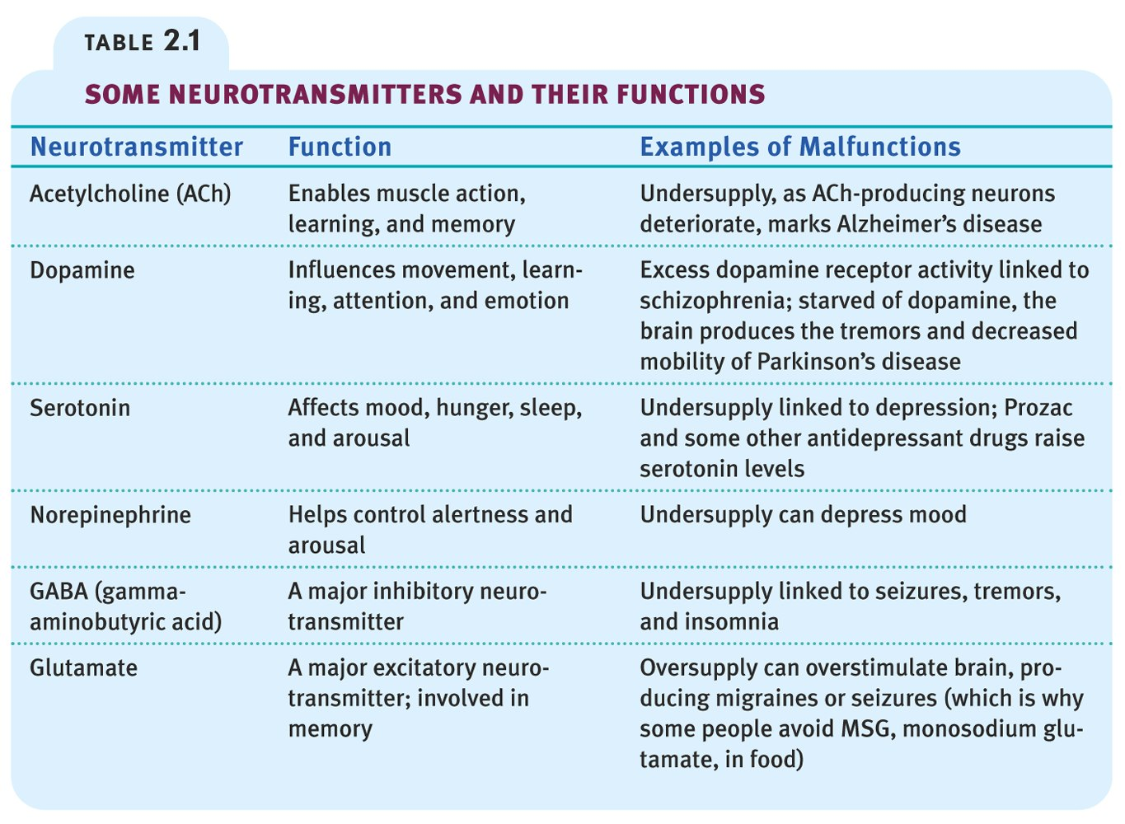
Neurotransmitters

Slide 17
Neurotransmitters
Acetylcholine [ah-seat-el-KO-leen] (Ach)
most common, best understood
a neurotransmitter that, among its functions, triggers muscle contraction
is involved in memory (a shortage of causes Alzheimer’s Disease)
Endorphins [en-DOR-fins]
“morphine within”
natural, opiate like neurotransmitters
linked to pain control and to pleasure

Slide 18
Dopamine-
Involved in the control of bodily movements, learning, attention, & emotion.
Shortage causes Parkinson’s disease
Excessive dopamine linked with schizophrenia
Seratonin
Affects mood, hunger, sleep and arousal

Slide 19
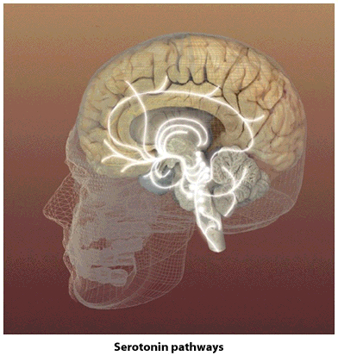
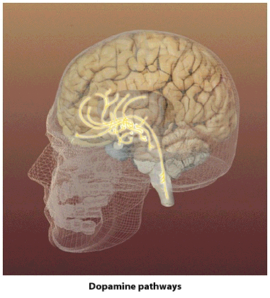
Neural Communication
Serotonin Pathways
Dopamine Pathways

Slide 20
Neural Communication
Neural communication refers to how the neurons relay messages to each other. It is referred to an electrochemical reaction.
Neurons are surrounded by fluid. The fluid inside a neuron contains negative charged atoms, called ions, ( - ) from the fluid located outside the neuron, which has positive charged ions (+).

Slide 21
Neural communication cont’d
The neural membrane only allows certain ions through the membrane.
Positively charged sodium and potassium ions and negatively charged chloride ions flow back and forth across the cell membrane, but they do not cross at the same rate. The difference in the flow leads to a higher concentration of negatively charged ions inside the cell.

Slide 22
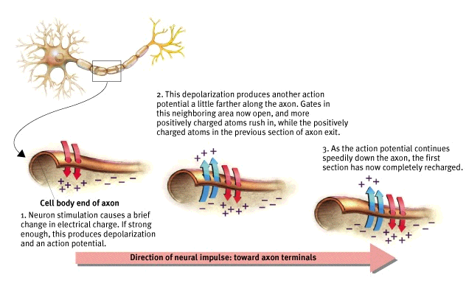
Neural Communication
Cell body end
of axon
Direction of neural impulse: toward axon terminals

Slide 23
The electrical impulse
Positive ions will flow into the neuron if not stopped or pumped out by the membrane. This is called the electrical potential, which is measured in millivolts.
The resting potential is the neuron’s usual charge, which is –70 millivolts.
When the resting potential has changed enough, about +10mv, the membrane changes and this is called the action potential.
Threshold potential: commonly (-55)mV- (-40)mV the axon needs to be depolarized at least this much in order to “open the gates” for more positive ions to flood in.

Slide 24
A neuron fires an impulse, when it receives signals from sense receptors…the impulse is called
Action Potential
a neural impulse; a brief electrical charge that travels down an axon, each tripping the next (depolarization)
generated by the movement of positively charged ions (atoms) in and out of channels in the axon’s membrane.
The speed at which an action potential travels the axon ranges from 2 to 250 mph.

Slide 25
More Vocab
Refractory Period- a resting pause, when the neuron pumps the positively charged ions back outside…then it can fire again.
The neuron’s reaction is an “all or none response.”
Neurons either fire or they don’t. (like a gun)
Inhibitory-signal to stop the message
Excitatory: signal to send the signal
Threshold -the level of stimulation required to trigger a neural impulse

Slide 26
How drugs affect neurotransmission
Agonist-excite by mimicking particular neurotransmitters or block their reuptake.
Antagonists-inhibit a neurotransmitter’s release or block its effect.

Slide 27
PHRENOLOGY
Invented by Franz Gall in the early 1800’s.
A theory that claimed that bumps on the skull could reveal our mental abilities and character traits.
Phrenology focused the attention that various regions of the brain have particular, specific functions.

Slide 28
