Slide 1
Learning
Cerepak 2015

Slide 2
Learning
A relatively permanent change in an organism’s behavior due to experience
Classical Conditioning
Operant Conditioning
Observational Learning

Slide 3
Classical Conditioning
Ivan Pavlov
John B. Watson and “Little Albert”
Dogs trained to salivate (CR) to sound of bell (CS)
An infant was conditioned to fear a white rat by pairing it with a loud noise.
What is the:
UCS, UCR, CS, CR?
Generalization: Little Albert was afraid of dogs, monkeys and even fur coats!
This experiment taught us that most of our fears are learned and not inborn.

Slide 4
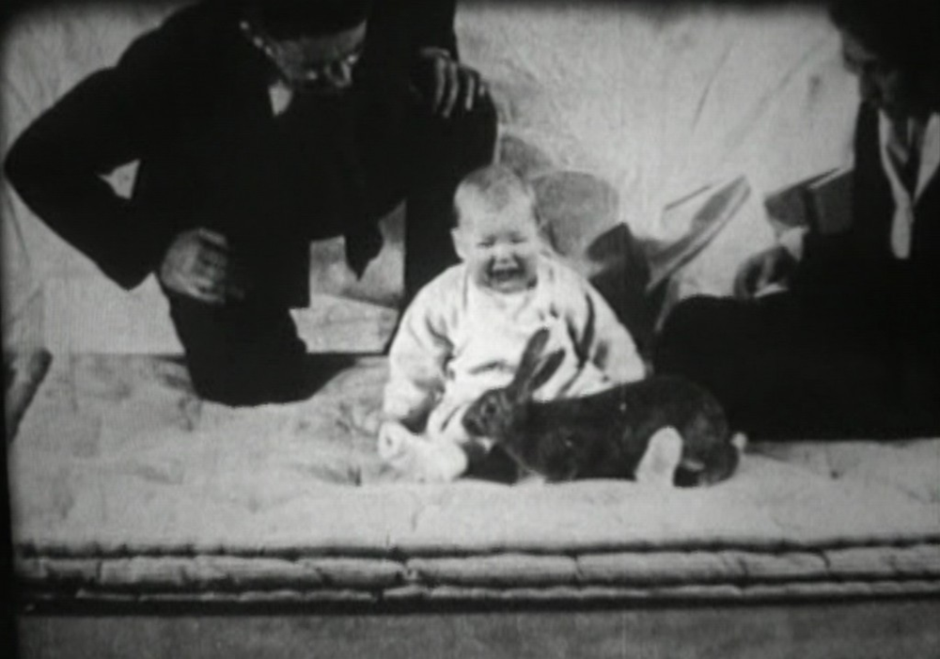
Little Albert- Generalization

Slide 5
John B. Watson
Behaviorism: the view that psychology should 1) be an objective science that 2) studies behavior without reference to mental process. Most research psychologists today agree with (1) but not (2)
“Forget that psychoanalytic stuff! Where’s the proof (observable behavior)?”

Slide 6
Applications of Classical Conditioning
Advertising: Some advertising companies hope to persuade you to buy their products by pairing them with pleasant things such as music and photographs
Taste Aversions:
Rats became nauseated (CR) when presented with sweetened water (CS) that had been paired with radiation (UCS) (which causes nausea- UCR)
One form of helping people lose weight is to pair the person’s favorite foods with noxious odors thus decreasing the person’s affinity toward that food.

Slide 7
Cognitive Processes and Biological Predispositions
Cognitive Processes Role in Classical Conditioning: Conditioning principles are affected by our thoughts, perceptions and expectations. For example: if we give alcoholics an alcoholic drink that will make them feel nauseous, they will not generalize the association to all alcohol. Rather, they are aware that it is the drug making them queasy, not the alcohol itself.
Don’t forget biology! Humans and other species are biologically predisposed to learn certain associations (plants with illness, snakes and fear) in order to enhance our survival. Outside the laboratory, a CS tends to have a natural association with the US it predicts.

Slide 8
Operant Conditioning
A type of learning in which behavior is strengthened if followed by a reinforcer or diminished if followed by a punisher.
Classical Conditioning involves respondent behavior (automatic behavior like salivating, fear)
Operant Conditioning involves operant behavior: behavior that operates on the environment, producing consequences.
Law of Effect: Thorndike’s principle that behaviors followed by favorable consequences become more likely and those followed by unfavorable consequences become _____ ________.

Slide 9
Thorndike’s Cat in a puzzle box
Thorndike enticed cats to get out of a puzzle box through a series of maneuvers.
The cats performance tended to improve over time which supported his Law of Effect.

Slide 10
B.F. Skinner’s “Operant Chamber”
AKA Skinner Box
A box that contained a lever or a key that an animal can manipulate to produce reinforcers such as food and water.
The lever had attached devices that would record the rate of pressing or pecking in experiments.

Slide 11
Shaping behavior
Shaping: an operant conditioning procedure in which reinforcers guide behavior toward closer and closer approximations of the desired behavior

Slide 12
Reinforcers
Reinforcement- the process of giving the animal something that makes a behavior more likely to occur is a reinforcer.
Positive Reinforcement: the addition of something pleasant
Negative reinforcement the removal of something unpleasant
Escape learning allows one to terminate an aversive stimulus
Avoidance learning enables one to avoid the aversive stimulus all together

Slide 13
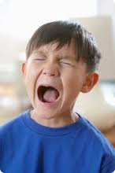
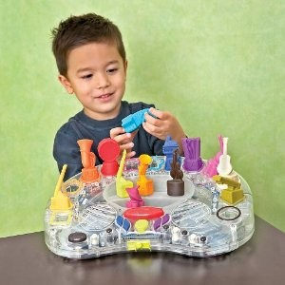
Reinforcers-can you identify them?

Slide 14
Negative Reinforcement

Slide 15
Primary and Secondary Reinforcers
Primary reinforcers: rewarding in and of themselves
Examples: food, water, rest
Secondary reinforcers: things we have learned to value
Examples: praise, the chance to play a video game,
Money-a generalized reinforcer because it can be traded for almost anythings

Slide 16
Reinforcement Schedules
Continuous Reinforcement- reinforce behavior every time it happens. Downside?
Partial (intermittent) reinforcement- reinforcing a response only part of the time. Results: slower acquisition of response; more resistant to extinction.
1) Fixed-ratio schedules: reinforces a response only after a specified number of responses.
2) Variable-ratio schedules: reinforces a response after an unpredictable amount of responses.
3) Fixed-interval schedules: reinforces behavior after a fixed amount of time has passed.
4) Variable-interval schedules?

Slide 17
Which reinforcement schedule are these people using?
Door to door salesman?
Checking the cookies to see if they are done?
Airline frequent flier miles that offer a free flight after every 25,000 purchased?

Slide 18
Punishment
Decreasing the likelihood of a behavior by using unpleasant consequences
Positive punishment: the addition of something unpleasant
Negative punishment: “omission training” the removal of something pleasant

Slide 19
In your notebook- write your answer to this question.
What is the difference between negative and positive punishment, and negative reinforcement?

Slide 20
Drawbacks of Punishment
Suppressing rather than changing unwanted behaviors
Teaching aggression- showing aggression is a good way to cope with problems.
Creating Fear-associating punishment not only with the Bx but with the person and/or setting
Encouraging discrimination- only doing them when they know they won’t get caught.
Combo of reinforcement and punishment work better than punishment alone (ex: kids with special needs that exhibit self-harming behaviors).
Skinner: “What punishment often teaches, is how to avoid it”
Now psychologists emphasize reinforcement.

Slide 21
While booting up your laptop:
Read each scenario and identify whether the reinforcement schedule is a:
Fixed-interval
Fixed-ratio
Variable-interval
Variable-ratio
Weebly:
-AP Psych
Operant Conditioning Lesson
Read the instructions- you may complete this on your computer and print it.

Slide 22
Closure
What are some real world applications of Operant Conditioning?
How effective are they?
Do you have a real-life application of operant conditioning in your own life?
Homework:
Read and outline Learning by Observation in your book (p. 341-347) if you have not already done so.
Timed Quiz on Wednesday. Fifteen questions in 15 minutes. Study your notes ahead of time! (All of Chapter 8)

