Slide 1
Aging and Adulthood
Myers 8th Edition
Objectives Overview

Slide 2
True or False?
Older people become more susceptible to short-term illnesses.
During old age, many of the brain’ neurons die.
If they live to be 90 or older, most elderly people eventually become senile.
Recognition memory (the ability to identify things previously experienced) declines with age.
Life satisfaction peaks in the fifties and then gradually declines from there.

Slide 3
Physical Changes in Middle Adulthood
Muscular strength, reaction time and sensory abilities and cardiac output begin to decline in late 20s
Around 50, women experience an end to fertility; menopause but do not experience depression or other psychological problems

Slide 4
Life expectancy changes
Worldwide:
Mid 1900s: 47 years
Now: 67 years; up to 80 in some developed countries
The elderly is a growing population
Europe 2050: 30% of pop will be >60 years old
Some developed countries will see a population decline
Women outlive men (embryos, infancy and beyond) By 100, women outlive men 5:1

Slide 5
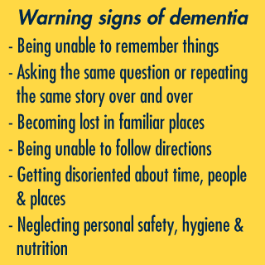
Health and Aging
Immune System weakens- more susceptible to terminal illness like cancer and pneumonia
Neural processes slow and the brain shrinks by about 5% by age 80.
Physical exercise can promote the growth of new brain cells and connections
Chance of dementia doubles every five years past age 60

Slide 6
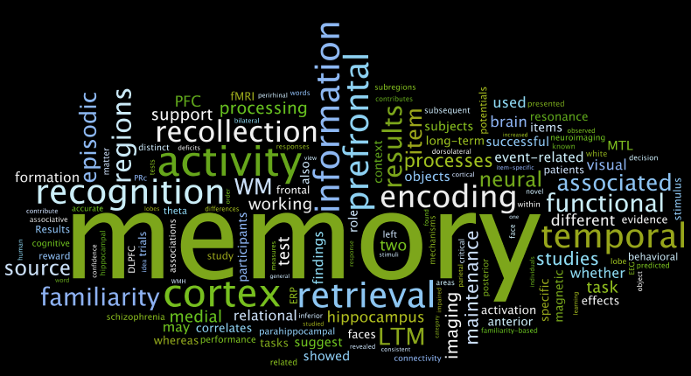
Aging and Recall/Recognition
Recalling new informing declines but recognizing it does not
Older adults recall meaningful information better than meaningless information but the time it takes to produce the words to tell the story does increase.

Slide 7
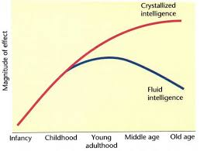
Aging and Intelligence
Cross-Sectional Studies: comparing different age groups against each other showed that intelligence decreases over time but failed to account for generational differences
Longitudinal Studies show that intelligence stays stable until very late in life; however, it does not account for the study drop outs (were they less intelligent?)
Crystallized Intelligence: accumulated knowledge and skills
Fluid Intelligence: the ability to reason speedily and abstractly

Slide 8
Mid-life Crisis?
Psychologists doubt that adults pass through age-bound stages
Life Crisis are more produced by changes (divorce, meeting of a partner) than age

Slide 9
Love, Marriage and Adulthood
Evolutionary Psychologists believe that staying with a partner and raising children together increased the chances of passing on genes
Chances of divorce has doubled over the past 40 years. Why?

Slide 10
Marriage and Life Satisfaction
Most people do still expect to marry and those that do tend to be happier than their single counter-parts
The birth of a child is a welcome event in life; however, it also strains financial and emotional resources.
What are emotional resources?

Slide 11
Career Choices, Life Satisfaction and Age
Settling into a career path is difficult and time-consuming but finding one that matches your interests is positively correlated with life satisfaction.
Well-being and people’s feelings of satisfaction are stable among the life-span; however, the highs are less-high and the lows are less-low.

Slide 12
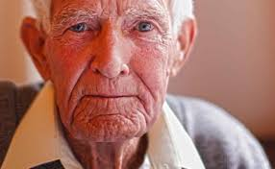
Death and Grief
There is no “normal” reaction or series of stages after the death of a loved one.
Grief is most severe when it is unexpected or before an expected time as in the death of a child.
People who in old age achieve a sense of integrity, in Erikson’s terms, may meet death by affirming that their life was meaningful.

